Slide 1
AngularJS Framework
Notes:
Course Review Committee:
Review Date:

Slide 2
Warm up - Introductions
My role
Over 1 year working on AngularJS

Slide 3
Course Objectives
At the end of the course, you will have acquired foundation knowledge to:
  Understand basic concepts of AngularJS frameworks
  Know how to get started building AngularJS applications
  Advance your research to more deep topics and implement AngularJS into your project work
  DO NOT cover:
  Knowledge of HTML & JavaScript and also basic concepts of web development

Slide 4
Agenda
Introduction to AngularJS
Dependency Injection
Create Directives
Routing
Unit Test

Slide 5
Course Audience and Prerequisites
Audience: Software Engineer
Prerequisites:
  Basic understanding of JavaScript and HTML/CSS
  Hand on working with JavaScript
  Preferred to have knowledge on software architecture pattern (MVC, MVVM, MVP)
  Preferred to have knowledge on Dependency Injection

Slide 6
Assessment Disciplines
Class Participation: 100%
Assignment: 60%
Final Exam: 40%
Passing Scores: 60%

Slide 7
Duration and Course Timetable
Course Duration: 9 hrs
Course Timetable:
  From 9AM to 12PM
  Break 15 minutes from 10:30AM to 10:45AM

Slide 8
Further References
AngularJS official site
  https://docs.angularjs.org/guide
Others
  https://egghead.io/
  https://github.com/angular-ui/ui-router/wiki
  http://stackoverflow.com/questions/14049480/what-are-the-nuances-of-scope-prototypal-prototypical-inheritance-in-angularjs

Slide 9
Set Up Environment
To complete the course, your PC must install:
  Web browser
  Text editor

Slide 10
Course Administration
In order to complete the course you must:
  Sign in the Class Attendance List
  Participate in the course
  Provide your feedback in the End of Course Evaluation

Slide 11
Introduction to
AngularJS Framework
Notes:
Course Review Committee:
Review Date:

Slide 12

What is AngularJS?
It is a structural JavaScript framework for dynamic web apps
It extends HTML attributes with Directives, and binds data to HTML with Expressions
It is distributed as a JavaScript file, and can be added to a web page with a script tag

Slide 13
Why AngularJS?
“HTML is great for declaring static documents, but it falters when we try to use it for declaring dynamic views in web-applications. AngularJS lets you extend HTML vocabulary for your application. The resulting environment is extraordinarily expressive, readable, and quick to develop”
-- AngularJS.org
Use plain JavaScript objects
Extending HTML capability with custom directives
Designed as a MVW Framework
Powerful and flexible filters
Write less but clean code.
Dependency Injection makes AngularJS code easy to write unit test

Slide 14
MVW Framework
Model-View-Whatever - A paradigm that separate a framework to Model, View and another module – Whatever.
Less dependencies
Improves maintainability
It is easier to read and understand code
Notes:
MVW is a general concept, it includes MVC, MVVM, MVP

Slide 15
Setup AngularJS
Declare Angular section
Import Angular script
Declare Angular root app
<html >
<head>
<script src="https://ajax.googleapis.com/ajax/libs/
angularjs/1.4.7/angular.min.js">
</script>
</head>
<body ng-app>
</body>
</html>
Import Angular script
Declare Angular root app
Notes:
The inclusion of AngularJS script makes the angular namespace object available globally.
Demo location: hello/hello.html

Slide 16
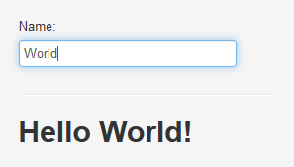
Hello World Example
Declare Angular section
<html >
<head>
<script src="https://ajax.googleapis.com/ajax/libs/
angularjs/1.4.7/angular.min.js"></script>
</head>
<body ng-app="myApp">
  <div ng-controller="HelloController">
  Name:
  <input type="text" ng-model="name" />
  <h1>Hello {{ name }}</h1>
  </div>
  <script>
  var myApp = angular.module('myApp', []);
  myApp.controller('HelloController', function($scope){
  $scope.name = 'World';
  });
  </script>
</body>
</html>
Notes:
The inclusion of AngularJS script makes the angular namespace object available globally.
Demo location: hello/hello.html

Slide 17
Bootstrap AngularJS
Two ways: automatic and manual.
Cannot add controllers, services, directives, etc... after an application bootstraps.
<html ng-app="myApp">
<head>
...
</head>
<body ng-app="myApp">
...
<div id="content" ng-app="myApp">
...
</div>
...
</body>
</html>
angular.module('myApp', [])
.controller('MyController', function ($scope) {
$scope.greetMe = 'World';
}]);
angular.element(document).ready(function(){
angular.bootstrap(document, ['myApp']);
});
Notes:
Notice that angular.bootstrap will not create modules on the fly. You must create any custom modules before you pass them as a parameter.

Slide 18
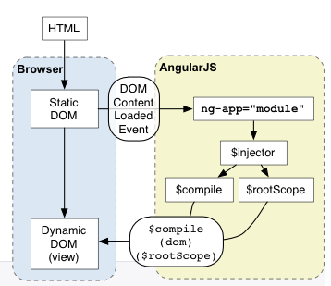
Bootstrap AngularJS
Angular loads the module associated with the directive
Creates the application $injector
$injector is used to retrieve object instances as defined by provider, instantiate types, invoke methods, and load modules.
The injector will then create the root scope that will become the context for the model of our application.
Angular will then "compile" the DOM starting at the ng-app root element, processing any directives and bindings found along the way.
Reference source: http://angularjs.org
Notes:
Angular initializes automatically upon DOMContentLoaded event or when the angular.js script is evaluated if at that time document.readyState is set to 'complete'.
At this point Angular looks for the ng-app directive which designates your application root. If the ng-app directive is found then Angular will:
- load the module associated with the directive.
- create the application injector
- compile the DOM treating the ng-app directive as the root of the compilation.
This allows you to tell it to treat only a portion of the DOM as an Angular application
Every application has a single root scope. All other scopes are descendant scopes of the root scope. Scopes provide separation between the model and the view, via a mechanism for watching the model for changes. They also provide an event emission/broadcast and subscription facility.
$injector is used to retrieve object instances as defined by provider, instantiate types, invoke methods, and load modules.
The $provide service has a number of methods for registering components with the $injector. Many of these functions are also exposed on angular.Module.

Slide 19
Data Binding
Automatic synchronization of data between the model and view components.
AngularJS implements Two-way Data-binding lets us treat the model as the single-source-of-truth in application.
The view is a projection of the model at all times. When the model changes, the view reflects the change, and vice versa.
Reference source: http://angularjs.org

Slide 20
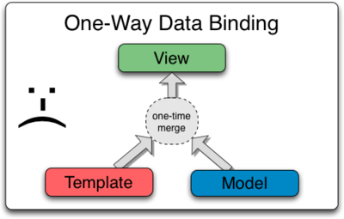
Data Binding
One-way data binding (In Classical Template Systems)
  Merge Template and Model components into a View.
  Need to code to reflect changes in Model to View and vice versa.
Reference source: http://angularjs.org

Slide 21
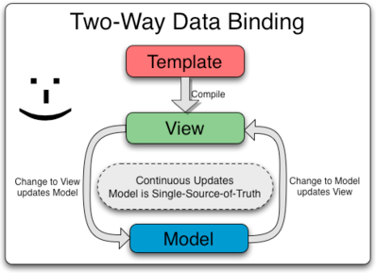
Data Binding
Two way Data Binding (AngularJS way)
  View is updated automatically when the Model is changed
  Model is updated automatically when a value in the View has changed
  The model is the single-source-of-truth for the application state, and view is just an instance projection of model.
Reference source: http://angularjs.org

Slide 22
Controllers
Define the application’s behavior
Controller create its new $scope
Set up properties/behaviors of the $scope object.
Controllers use $scope to expose controller’s methods to templates
Unlike services, there can be many instances in an app
myApp.controller('MyController', function($scope) {
$scope.naomi = { name: 'Naomi',
address: '1600 Amphitheatre'
};
$scope.addNumber = function(x, y) {
return x + y;
};
});

Slide 23
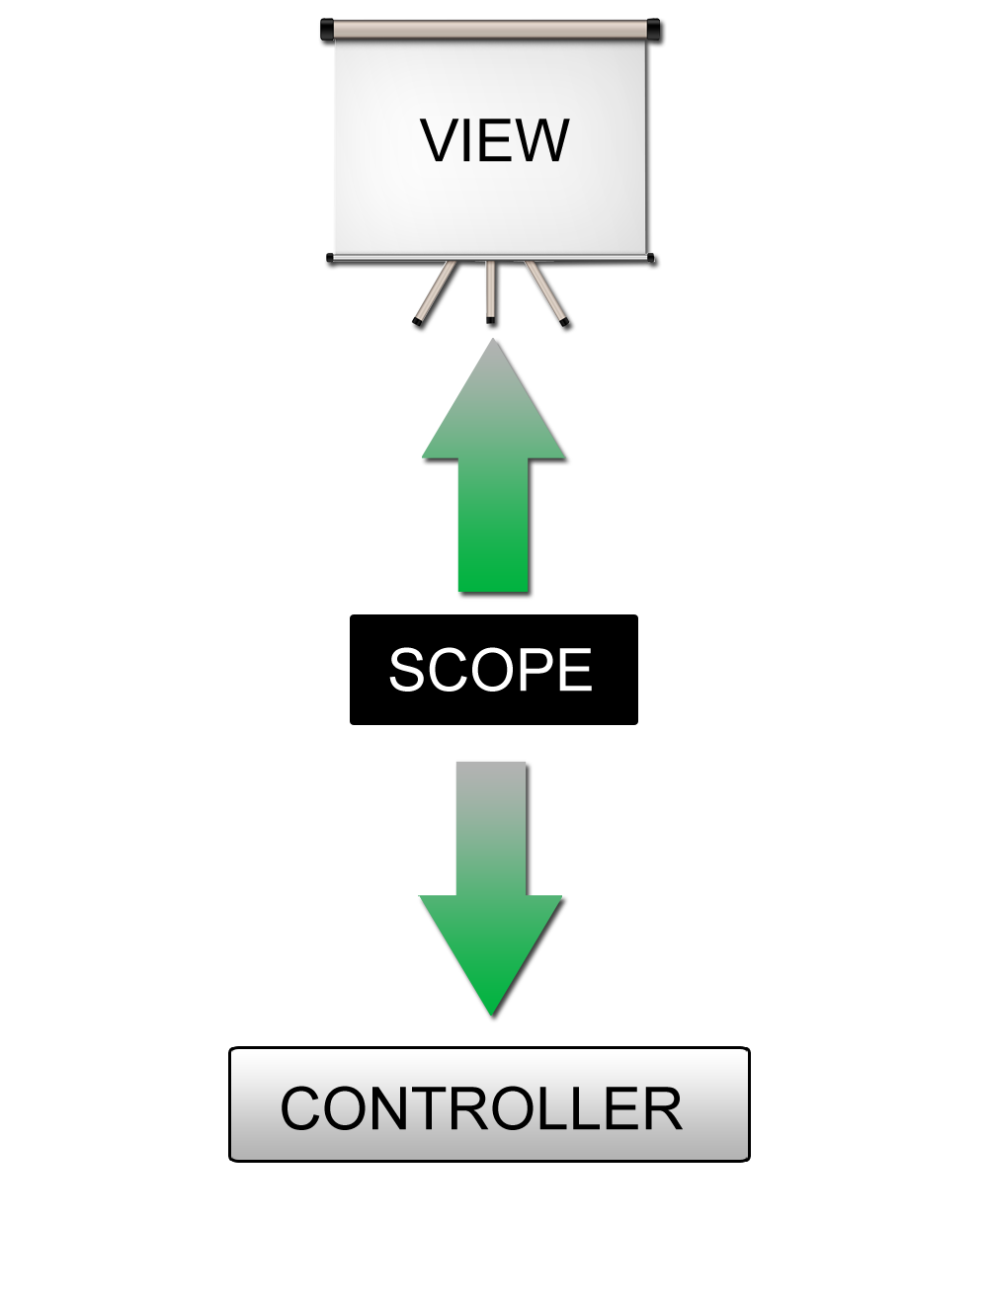
Scopes
$scope is an object that refers to the Model.
A hash of key/values
One scope for each controller
The GLUE between the View and the Controller
An execution context for expressions
Controllers and directives have reference to the scope but not to each other
Reference source: http://angularjs.org

Slide 24
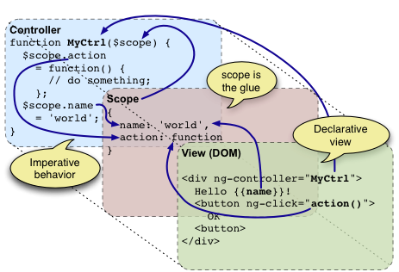
Scopes
An execution context for expressions
Controllers and directives have reference to the scope but not to each other
Reference source: http://angularjs.org

Slide 25
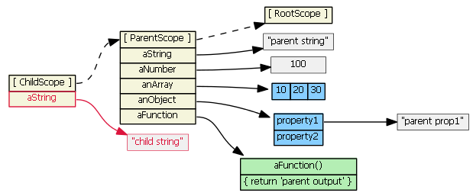
Scopes
Scopes are arranged in hierarchical structure which mimic the DOM structure of the application.
Child scopes prototypically inherit from their parents
Exactly one $rootScope, but may have several child scopes.
If a property is not find, angular searches in parent scope and so on.
Reference source: http://github.com

Slide 26
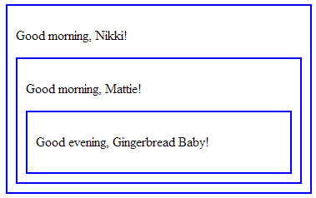
Scopes
Some directives creates new child scopes
Demo
<div class="spicy">
<div ng-controller="MainController">
<p>Good {{timeOfDay}}, {{name}}!</p>
<div ng-controller="ChildController">
<p>Good {{timeOfDay}}, {{name}}!</p>
<div ng-controller="GrandChildController">
<p>Good {{timeOfDay}}, {{name}}!</p>
</div>
</div>
</div>
</div>
Notes:
Demo location: scope/scope-inherit.html

Slide 27
Scopes
Core methods for two way binding
  scope.$watch to observe model mutations
  scope.$apply to propagate any model changes through the system into the view from outside of the "Angular Realm”
$scope.$watch('elapsed', function(){
if ($scope.elapsed > 0)
$scope.text = $scope.text + " World";
});
setTimeout(function(){
var delta = (new Date().getTime() - $scope.startedTime.getTime());
$scope.elapsed = Math.round(delta / 1000);
$scope.$apply();
}, 3000);
Demo
Notes:
Demo location: scope/scope-watch.html

Slide 28
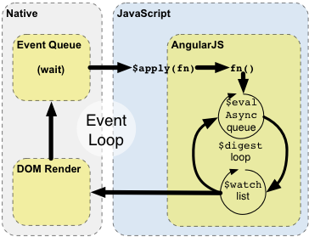
Scopes
Every time we bind something in the UI we insert a $watch in a $watch list
User: <input type="text" ng-model="user" />
Password: <input type="password" ng-model="pass" />
{{text}}
function $apply(expr) {
try {
return $eval(expr);
} catch (e) {
$exceptionHandler(e);
} finally {
$root.$digest();
}
}
Reference source: http://angularjs.org

Slide 29
Scopes
Scopes can propagate events in similar fashion to DOM events
  $scope.$broadcast (‘paid‘, data): propagate to child scopes
  $scope.$emit(‘paid‘, data): propagate to parent scope
  $scope.$on(‘paid’, fn): capture event in destination scope
Demo
Notes:
Broadcast event in scope hierarchy This is how controllers can communication to each other
Demo location: scope/scope-event.html

Slide 30
Services
To organize and share code across your app
Dependency for the other components (controller, service, filter or directive)
Services is singleton and lazily instantiated
myApp.service('mathService', function(win) {
this.pi = 3.14;
this.add = function(x, y) {
return x + y;
}
this.multiply = function(x, y) {
return x * y;
}
});

Slide 31
Service Injection
Inline array injection annotation
$inject property
Implicit injection: determine the dependency from the name of the parameter.
myApp.controller('MyController', ['mathService', function(mathService) { ... }]);
var MyController = function(mathService) { ... };
MyController.$inject = ['mathService'];
myApp.controller('MyController', MyController);
myApp.controller('MyController', function($scope, mathService) {
$scope.sum = function(a, b) {
return mathService(a, b);
};
});
Notes:
The dependency injector also takes care of creating any transitive dependencies the service may have

Slide 32
Built-in services
Name begins with $
Available to inject into any components.
There are many Built-in services that can be wired using DI similar to other services.

Slide 33
Built-in services
$http: A low level HTTP request helper that facilitates communication with the remote HTTP servers.
  Basically, an XMLHttpRequest wrapped
  Automatically serializes and de-serializes JSON
  Can be used for cross application concerns like authentication, error handling and logging,…
  Returns a promise object with two $http specific methods: success and error
$http({method: 'GET', url: '/someUrl'}).
success(function(data, status, headers, config) {
// this callback will be called asynchronously
// when the response is available
}).
error(function(data, status, headers, config) {
// called asynchronously if an error occurs
// or server returns response with an error status.
});
Reference source: http://codeschool.com

Slide 34
Expressions
An “expression" in a template is a JavaScript-like code snippet that allows to read variables.
In Angular, expressions are evaluated against a scope object, JavaScript expressions are evaluated against the global window
Use filters within expressions to format data before displaying it.
{{1+2}}
{{a+b}}
{{user.name}}
{{ expression | filter }}
Notes:
Broadcast event in scope hierarchy This is how controllers can communication to each other

Slide 35
Filters
A filter is used to format the value of an expression for displaying to the user
  Uppercase a value,
  Filter search results, etc.
Can be used in view templates, controllers or services
Create filter by registering a factory function to $injector
{{user.name | upperCase}}
module.filter(‘upperCase’, function() {
return function(text){
return text.toUpperCase();
}
});

Slide 36
Filters
Filters can be chained in pipe
{{user.name | filter1 | filter2 | ...}}
Filters with over two arguments
  The first is output of the pipe
  The second and following ones are explicit declared
Use filter as a service
{{user.fullname | displayFullname: ‘locale’}}
$scope.items = $filter('orderBy')(itemsArray, "Name");
myApp.controller('MyCtrl', function(orderByFilter){
$scope.items= orderByFilter(itemsArray, "Name");
});

Slide 37
Directives
Directives are markers on a DOM element
  Attach a specified behavior to that DOM element or
  Transform the DOM element and its children.
Two types
  Observing directives
  Listener directives
The HTML compiler traverses the DOM matching directives against the DOM elements.
Should be the only place in AngularJS app do manipulate DOM

Slide 38
Directives
Matching directives are called normalization
  Strip x- and data- from the front of the element/attributes.
  Convert the :, -, or _-delimited name to camelCase.
Best practice: use the dash-delimited format (e.g. ng-bind for ngBind)
$compile can match directives based on element names, attributes, class names, as well as comments.
<input ng-model="foo">
<input data-ng:model="foo">
<my-dir></my-dir>
<span my-dir="exp"></span>
<!-- directive: my-dir exp -->
<span class="my-dir: exp;"></span>

Slide 39
Built-in Directives
ng-model: binds an input,select, textarea (or custom form control) to a property on the scope
ng-bind: replace the text content of the specified HTML element with the value of a given expression
ng-click: specify custom behavior when an element is clicked
ng-controller: attaches a controller class to the view
ng-repeat: instantiates a template once per item from a collection. Each template instance gets its own scope
ng-class: dynamically set CSS classes on an HTML element
Demo
Notes:
Demo location: directive/builtin-directive.html

Slide 40
CSS classes
Angular automatically sets below CSS classes
  ng-scope angular applies this class to any element for which a new scope is defined
  ng-binding: angular applies this class to any element that is attached to a data binding
  ng-invalid, ng-valid: whether input does not pass validation
  ng-pristine, ng-dirty: whether user has interaction on input widget element

Slide 41
CSS classes
Source before typing email
Source after typing, with invalid email
Source after typing, with valid email
<input name="author" ng-model="reviewCtrl.review.author" type="email" required />
<input name="author" . . . class="ng-pristine ng-invalid">
<input name="author" . . . class="ng-dirty ng-valid">

Slide 42
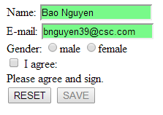
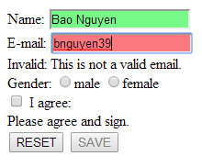
CSS classes
Lets highlight the form field using classes
.ng-invalid.ng-dirty {
border-color: #FA787E;
}
.ng-valid.ng-dirty {
border-color: #78FA89;
}

Slide 43
Animation
Animations in AngularJS are completely based on CSS classes
Animation hooks for common directives such as ngRepeat, ngSwitch, and ngView…
Custom directives via the $animate service
Demo for ngShow and ngHide
<head>
<script src="angular.min.js"></script>
<script src="angular-animate.js"></script>
<script type="text/javascript">
var myApp = angular.module('myApp', ['ngAnimate']);
</script>
</head>
Notes:
Demo location: animation/animate.html

Slide 44
AngularJS Boilerplates
Structure templates that contain best-practice directory structure to ensure code reusability and maximum scalability.
Used to initialize a new application.
Some popular generators: angular-seed, ngbp, yeoman,…
Notes:
Demo location: animation/animate.html

Slide 45
Dependency Injection
Notes:
Course Review Committee:
Review Date:

Slide 46
Module
Each Angular JS app contains at least one module
Create multiple modules help:
  Separate the code into individual concerns
  Improves unit-testability
Module is container for
  Services
  Directives
  Factories
  Filters
  Configuration information
Where to do the DI configuration for your app
Module can become dependence of another module in app
angular.module('moduleA', ['moduleB', 'moduleC']);

Slide 47
Module
Each module can only be loaded once per injector
Module configuration includes 2 block types
Configuration Blocks
  get executed during the provider registrations and configuration phase
  Only providers and constants can be injected into configuration blocks
Run Blocks
  A run block is the code which needs to run to kickstart the application
  It is executed after all of the service have been configured and the injector has been created
  Only instances and constants can be injected into run blocks

Slide 48
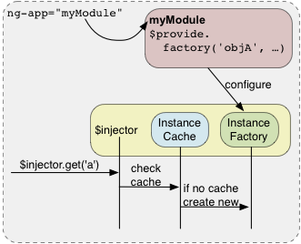
Injector
A registration center for the $provide object
$injector service instantiates/lookups objects and wires them together for the app to work
Reference source: http://angularjs.org

Slide 49
Injector
The injector creates two types of objects
  Services: custom objects by developer
  Specialized objects: Controller, Filter, Directive,…
All services in Angular are singletons
Registry of "recipes"
  An identifier of the object
  The description of how to create that object.
Support for recipe types
  Value
  Factory
  Provider
  Service
  Constant

Slide 50
Injector
The Factory recipe
  The return value of a factory function is the service instance
The Service recipe
  Injector invokes a constructor function with the new operator to create service instance
myApp.factory('unicornLauncher', ["apiToken", function(apiToken) {
return new UnicornLauncher(apiToken);
}]);
myApp.service('unicornLauncher', ["apiToken", UnicornLauncher]);

Slide 51
Injector
The Provider recipe.
  Define $get method directly
  Allow create services with configurable argument values
myApp.provider('unicornLauncher', function UnicornLauncherProvider() {
var useTinfoilShielding = false;
this.useTinfoilShielding = function(value) {
useTinfoilShielding = !!value;
};
this.$get = ["apiToken", function unicornLauncherFactory(apiToken) {
return new UnicornLauncher(apiToken, useTinfoilShielding);
}];
});
myApp.config(["unicornLauncherProvider", function(unicornLauncherProvider) {
unicornLauncherProvider.useTinfoilShielding(true);
}]);

Slide 52
Injector
The Value recipe
  Define simple object
The Constant recipe.
  Don't have dependencies
  Registered object can be called in the configuration phase of module
myApp.value('clientId', 'a12345654321x');
myApp.controller('DemoController', ['clientId', function DemoController(clientId) {
this.clientId = clientId;
}]);
myApp.constant('planetName', 'Greasy Giant');
myApp.config(['unicornLauncherProvider', 'planetName', function(unicornLauncherProvider, planetName) {
unicornLauncherProvider.stampText(planetName);
}]);

Slide 53
Create Directives
Notes:
Course Review Committee:
Review Date:

Slide 54
Create Directives
Why we create custom directives
  To create specific HTML elements for our project
  To wrap a repeatly used templates
  To adapt other javascript third party libraries into an AngularJS app
Directives are registered on modules
factoryFn is either
  Return a "Directive Definition Object“ that defines the directive properties
  Return the postLink function
module.directive('normalizedName', factoryFn);

Slide 55
Directive to Wrap a Repeatly Used Template
Used to apply DRY principle
This is same idea of using ngInclude

Slide 56
Directive to Wrap a Repeatly Used Template
Demo
angular.module('docsRestrictDirective', [])
.controller('Controller', ['$scope', function($scope) {
$scope.customer = {
name: 'Naomi',
address: '1600 Amphitheatre'
};
}])
.directive('myCustomer', function() {
return {
restrict: 'E',
templateUrl: 'my-customer.html'
};
});
<div ng-controller="Controller">
<my-customer></my-customer>
</div>
Notes:
Demo location: directive/template-directive.html

Slide 57
Directive to Wrap a Repeatly Used Template
Demo
angular.module('docsRestrictDirective', [])
.controller('Controller', ['$scope', function($scope) {
$scope.customer = {
name: 'Naomi',
address: '1600 Amphitheatre'
};
}])
.directive('myCustomer', function() {
return {
restrict: 'E',
templateUrl: 'my-customer.html'
};
});
<div ng-controller="Controller">
<my-customer></my-customer>
</div>
Notes:
Demo location: directive/template-directive.html

Slide 58
Directive to Wrap a Repeatly Used Template
restrict: attribute versus element?
  Use an element when you are creating a component that is in control of the template
  Use an attribute when you are decorating an existing element with new functionality.

Slide 59
Directive with Isolated Scope
By default new directive’s scope prototypically inherit from parent element’s scope
Isolate the directive template from parent element (except pass in)
Enforce reusability
angular.module('docsRestrictDirective', [])
.directive('myCustomer', function() {
return {
restrict: 'E',
scope: {
customerInfo: '=info'
},
templateUrl: 'my-customer-iso.html'
};
});
<div ng-controller="Controller">
<my-customer info="naomi"></my-customer>
<hr>
<my-customer info="igor"></my-customer>
</div>

Slide 60
Directive with Isolated Scope
If set to true or { }:
  New scope will be created for the directive
  If multiple directives on the same element request a new scope, only one new scope is created
Notation for property in scope:
  @ or @attr - bind a local scope property to the value of DOM attribute
  = or =attr - set up bi-directional binding between a local scope property and the parent scope property
  & or &attr - provides a way to execute an expression in the context of the parent scope
If no attr name is specified then the attribute name is assumed to be the same as the local name.
Demo
Notes:
We will consider with other alternative with scope properties
Demo location: directive/isolated-directive.html

Slide 61
Directive that Manipulates the DOM
Directives that want to modify the DOM typically use the link option
function link(scope, element, attrs) { ... }
Signature
  scope is an Angular scope object.
  element is the jqLite-wrapped element that this directive matches.
  attrs is a hash object with key-value pairs of normalized attribute names and their corresponding attribute values.
Demo
Notes:
Demo location: directive/manipulate-directive.html

Slide 62
Directive that Wraps Other Elements
When we want to pass in entire template not string or object
Using transclude to true compile the content of the element and make it available to the directive (where place ng-transclude)
Use &attr to allow to pass in function which also execute within outside scope context
Demo
angular.module('docsTransclusionDirective', [])
.directive('myDialog', function() {
return {
restrict: 'E',
transclude: true,
templateUrl: 'my-dialog.html'
};
});
Notes:
Demo location: directive/wrapper-directive.html

Slide 63
Directive ngModel
The most popular directive of AngularJS
Augments the HTML controls (input, radio,…) by providing the two-way data-binding
Support CSS classes:
  Class attribute of control is changed according to state
  ng-valid; ng-invalid; ng-pristine; ng-dirty
Binding to form and control state
  State of control is automatically stored/updated in properties
  $dirty; $error; $invalid; $pristine; $valid
Custom triggers
  Any change to the content trigger a model update and form validation
  This behavior can be overridden by using ng-model-options
AngularJS provides some validation directives for using with ngModal (required, pattern, minlength, maxlength, min, max)

Slide 64
Custom Form Validate
Adds a custom validation function to the ngModel.
The validation can occur in two phases
Model to View update phase:
  Whenever the bound model changes
  All functions in NgModelController#$formatters array are pipe-lined
  Format the value and change validity state of the form control through NgModelController#$setValidity.
View to Model update phase:
  Whenever a user interacts with a control
  NgModelController#$setViewValue is called → NgModelController#$parsers array are pipe-lined
  Format the value and change validity state of the form control through NgModelController#$setValidity.
Demo
Notes:
Demo location: form/custom-validate.html

Slide 65
Custom Form Controls using ngModel
Write your own form control as a directive using along with ngModal.
Implement $render() method
  To render the data
  Call after it passed the NgModelController#$formatters
Call $setViewValue() method
  Whenever the user interacts with the control and model needs to be updated.
  Usually done inside a DOM Event listener.
Demo
Notes:
Demo location: form/custom-control.html

Slide 66

Custom Form Controls using ngModel
angular.module('form-example2', []).directive('contenteditable', function() {
return {
require: 'ngModel',
link: function(scope, elm, attrs, ctrl) {
// view -> model
elm.on('blur', function() {
scope.$apply(function() {
ctrl.$setViewValue(elm.html());
});
});
// model -> view
ctrl.$render = function() {
elm.html(ctrl.$viewValue);
};
// load init value from DOM
ctrl.$setViewValue(elm.html());
}
};
});

Slide 67
Routing
Notes:
Course Review Committee:
Review Date:

Slide 68
Deep Linking and AJAX app
Deep Linking is a URL that allows navigate directly to a specific resource like a web page or a file.
  http://example.com/path/page
  http://example.com/
AJAX application
  Contents of AJAX sites are loaded by script
  Can’t bookmark or history browsing (back or forward)
Solutions: use ‘#’ in the URL
  http://www.example.com/home.html#introduction
  Browser would not refresh the page when the hash is changed.
  JavaScript need to listen for the change of the hash in the navigation bar and do actions.
<a href="#C4">See also Chapter 4.</a>

Slide 69
AngularJS Route
Help to create a layout style for application
Application routes in Angular are provided by $route service
  Wire controllers, view templates, and the current URL location in the browser
  It watches $location.url() and map the path to an existing route definition
  Used in conjunction with the ngView directive
<body>
<div ng-view></div>
</body>
Configure $route service
  Via $routeProvider in config block of module
  when(path, route): adds a new route definition to the $route service.
  otherwise(params): sets default route definition

Slide 70
AngularJS Route
Demo
  http://localhost/index.html#phones/ip5
  http://localhost/index.html#phones/
phonecatApp.config(['$routeProvider',
function($routeProvider) {
$routeProvider.
when('/phones', {
templateUrl: 'partials/phone-list.html',
controller: 'PhoneListCtrl'
}).
when('/phones/:phoneId', {
templateUrl: 'partials/phone-detail.html',
controller: 'PhoneDetailCtrl'
}).
otherwise({
redirectTo: '/phones'
});
}]);
Notes:
Demo location: route/index.html

Slide 71
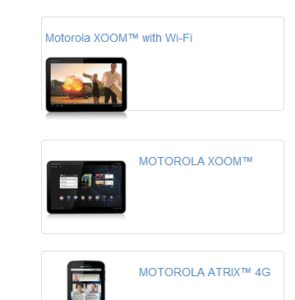

AngularJS Route
Demo (cont.)
Notes:
Demo location: route/index.html

Slide 72
AngularUI Router
Routing framework for AngularJS
Built by the AngularUI team
Organize routing by a state machine, rather than a simple URL route
Allows for nested views and multiple named views
Be ngRoute with more additional features
Routing

Slide 73
Unit Test
Notes:
Course Review Committee:
Review Date:

Slide 74
Unit Test
Why need to test
  Ensure reliability in production
  If it's hard to test, maybe it needs refactored?
  Let developers refactor with confidence if any
Angular Mock
  Inject and mock Angular services into unit tests
  Extends various core ng services
Recommended Testing Suite: Jasmine
Recommended Test Runner: Karma

Slide 75



Unit Test Steps
Install Node.js
Install Karma via npm
Configure Karma
Write Unit test using Jasmine
Run Karma to connect to a browser to run unit test

Slide 76
Karma Test Runner
Install Karma and command line
Init Karma configuration for our app, from command line type
Start Karma server
npm install -g karma;
npm install -g karma-cli;
karma init my.conf.js;
karma start my.conf.js;

Slide 77
Jasmine Framework
A behavior-driven development (BDD) framework for testing JavaScript code
  Describe a suite → describe
  Describe a spec → it
  Setup and teardown → beforeEach and afterEach
describe("A suite", function() {
var foo;
beforeEach(function() {
foo = 0;
foo += 1;
});
it("contains spec with an expectation", function() {
expect(foo).toEqual(1);
});
afterEach(function() {
foo = 0;
});
});

Slide 78
Unit Test Controller/Service
Controller is the most important thing to unit test in your angular app
Create controller mock and service mock, for instance
Demo
service = $injector.get('basicService');
ctrl = $controller('MainCtrl', {$scope: $scope, basicService: service});
Notes:
Demo location: unit-test/*test.js

Slide 79
Unit Test Directive
Directive involves to DOM element
Using $compile and angular.element() for testing
Demo

Slide 80
Points to Remember
Notes:
Course Review Committee:
Review Date:

Slide 81
Q&A
Notes:
Course Review Committee:
Review Date:

Slide 82
Thank You.
Notes:
Course Review Committee:
Review Date:

Slide 83
Revision History
Date | Version | Description | Updated by | Reviewed and Approved By
05/20/2014 | 1.0 | Initial Version | Bao Nguyen

